Slide 1

SMART INDIA HACKATHON 2026
BitCraft – Offline AI for Bitcoin Transaction Intelligence
Problem Statement ID – SIH26146
Problem Statement Title- AI-Powered Monitoring & Analysis of Bitcoin Transaction Traffic
Theme- Blockchain & Cybersecurity
PS Category- Software
Team ID- 192760
Team Name – BitCraft_

Slide 2
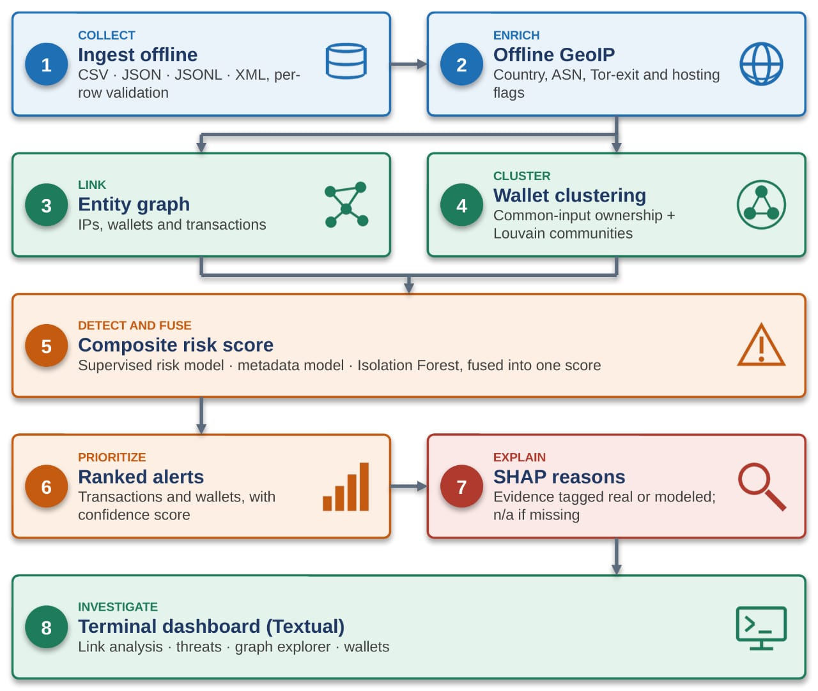
BitCraft_
IDEA TITLE
Proposed Solution:
Ingest offline: bulk transaction and network metadata (CSV, JSON, JSONL, XML) with per-row validation and reject reasons.
Enrich: offline GeoIP country, ASN and organisation (DB-IP Lite), with Tor-exit and hosting flags.
Link and cluster: entity graph of IPs, wallets and transactions; wallet clustering by common-input-ownership; Louvain communities.
Detect: supervised risk model, metadata model and Isolation Forest fused into one composite score.
Explain: ranked transaction and wallet alerts with confidence score, SHAP reasons and evidence tagged real or modeled. Missing network data shows n/a, never low risk.
Investigate: terminal dashboard with link analysis, threat overview, graph explorer and wallets. Install with one command: pipx install bitcraft.

Slide 3
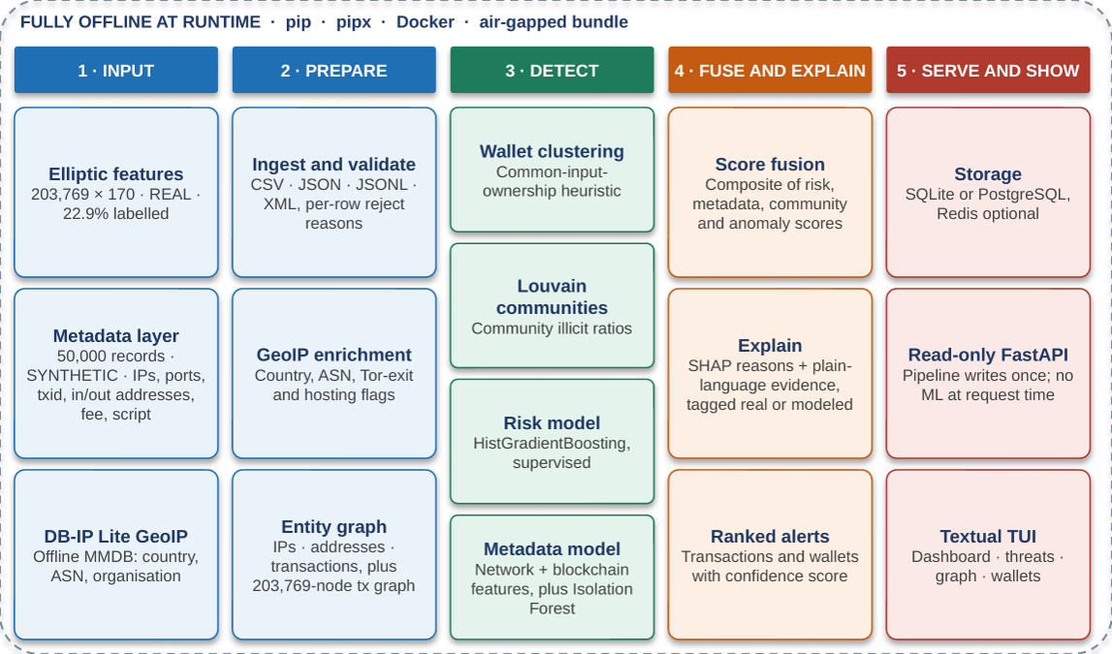
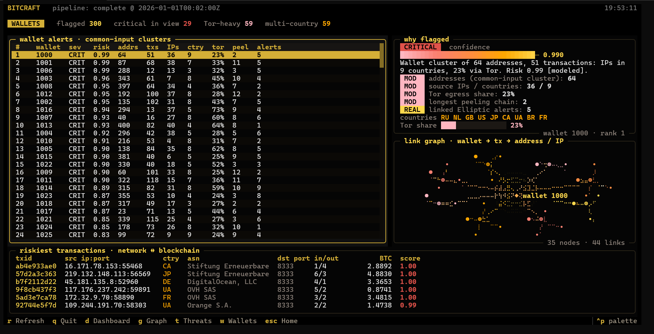
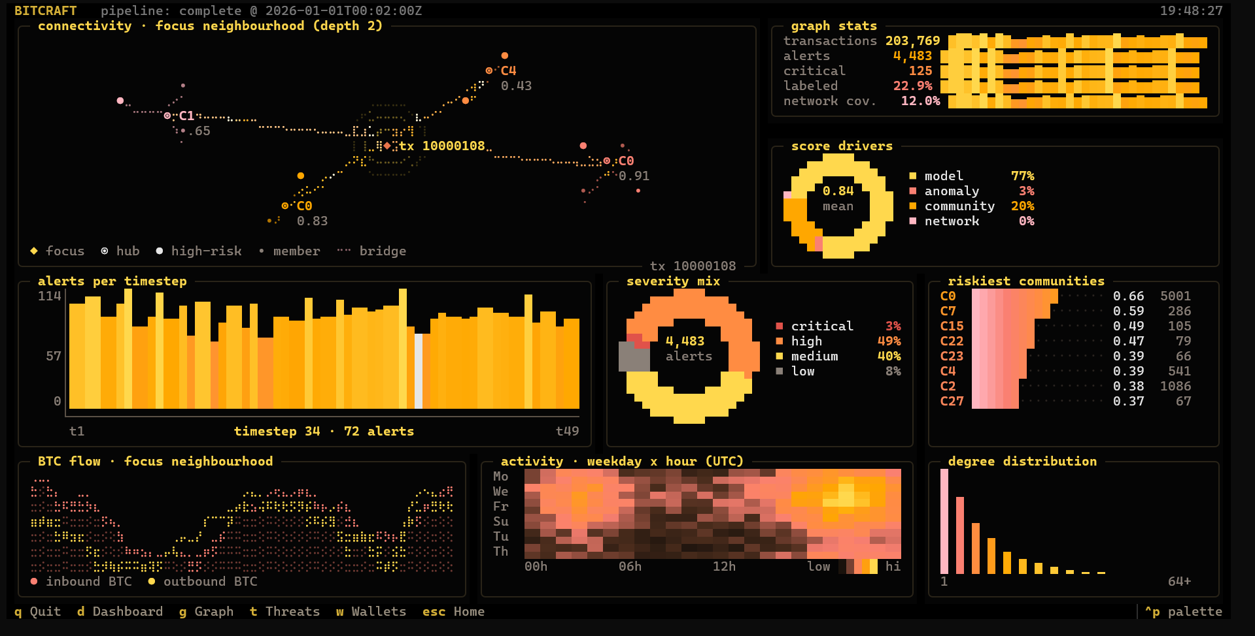
TECHNICAL APPROACH
BitCraft_
Links:
Demo Video (YouTube) : https://youtu.be/RtBhYRXpPeg?si=GVh9zHKuAgrvfE90
Code Repo (GitHub) : https://github.com/RohanOnKeys/bitcraft
pypi package (published) : https://pypi.org/project/bitcraft

Slide 4
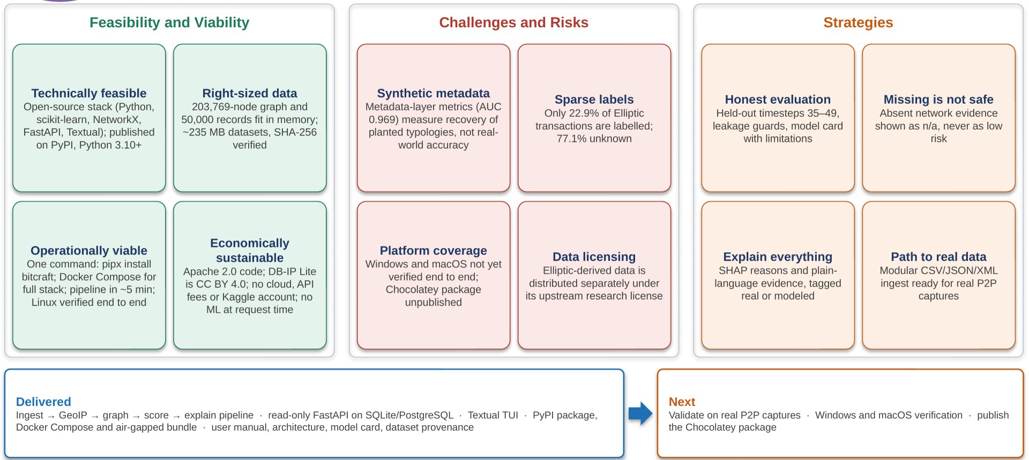
FEASIBILITY AND VIABILITY
BitCraft_

Slide 5
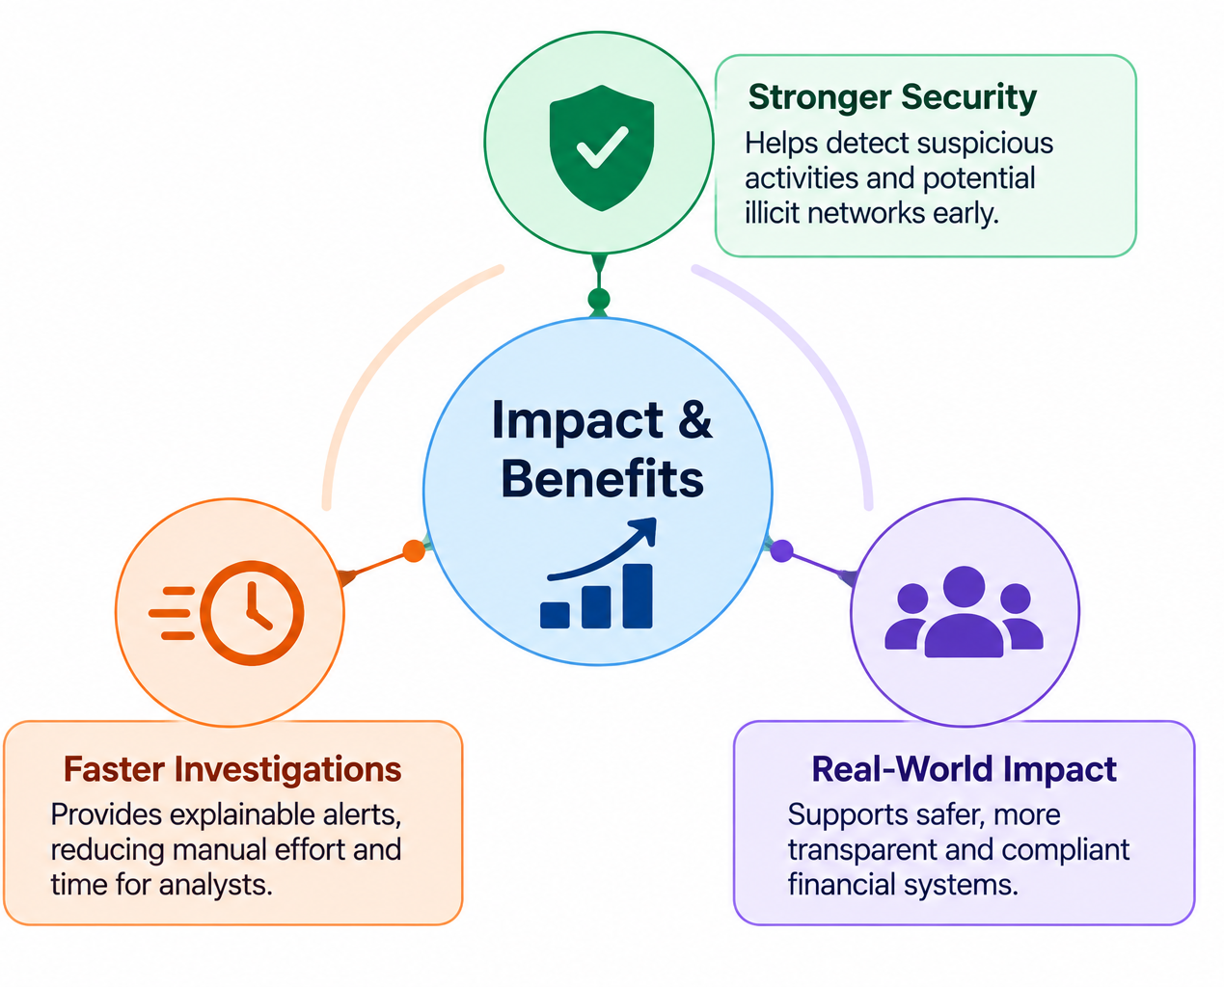
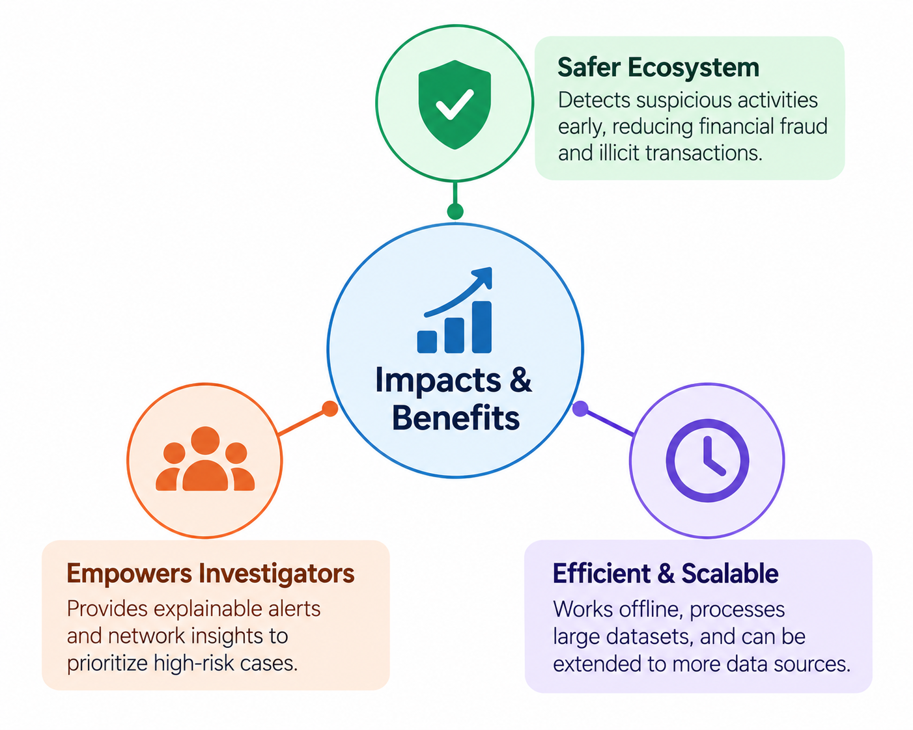
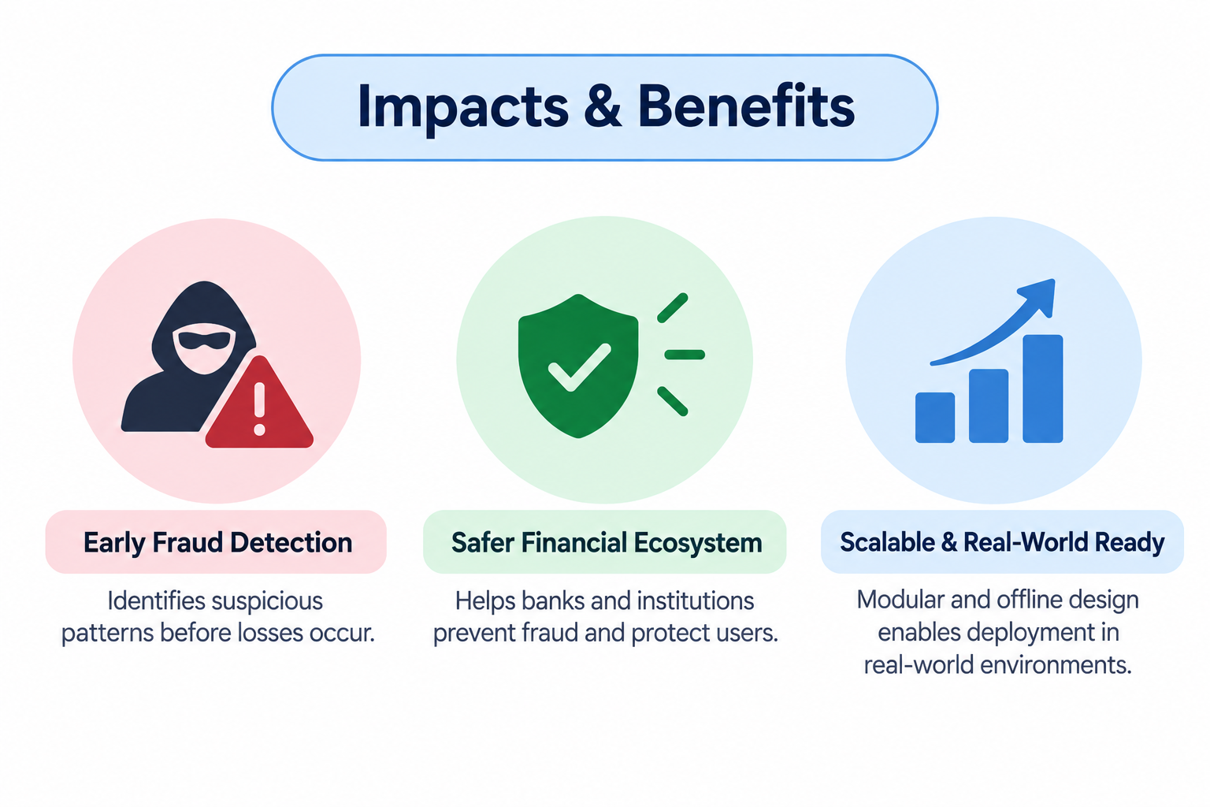
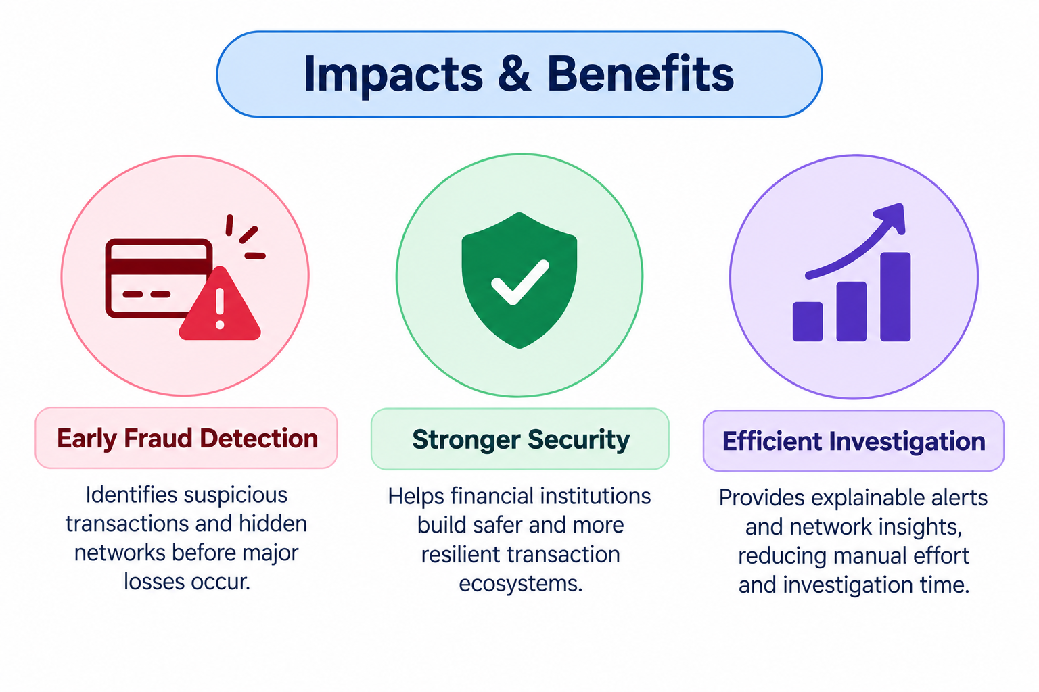
IMPACT AND BENEFITS
BitCraft_
1. Early Fraud Detection
Identifies suspicious transaction patterns
Detects abnormal and emerging activity
Helps uncover hidden transaction networks
2. Faster & Explainable Investigation
Prioritizes high-risk transactions
Provides evidence-based, human-readable alerts
Reduces manual analysis effort
3. Secure & Scalable Deployment
Fully offline for sensitive environments
Handles large transaction datasets
Modular architecture allows integration of additional data sources
Core Impact:
Massive transaction data prioritized, explainable investigative leads

Slide 6
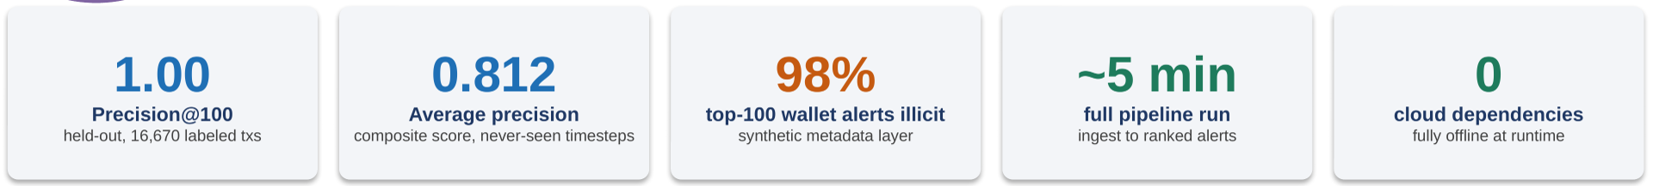
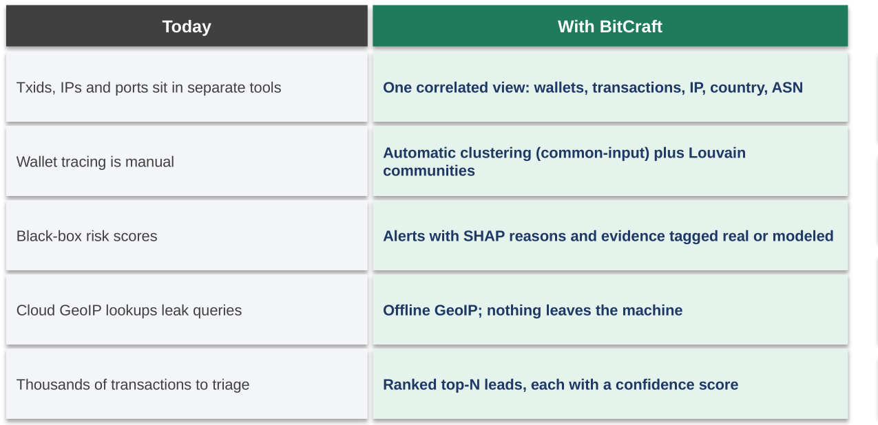
IMPACT AND BENEFITS
BitCraft_
What sets it apart
Air-gapped ready
Offline bundle with every wheel, image and dataset
Honest by design
Missing network evidence is n/a, never low risk
Deploy in one command
pipx, pip or Docker; terminal-first for analysts
Core impact: massive transaction data → prioritized, explainable investigative leads

Slide 7
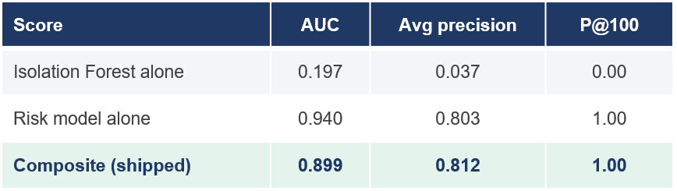

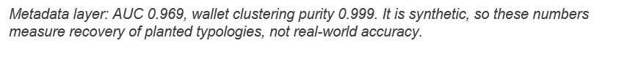
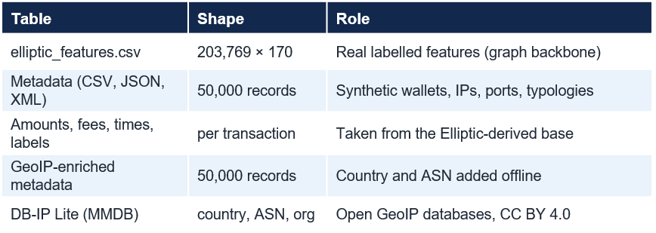
RESEARCH AND REFERENCES
BitCraft_
[1] Weber M. et al. (2019). Anti-Money Laundering in Bitcoin: Experimenting with Graph Convolutional Networks for Financial Forensics, introduces the Elliptic dataset. arXiv:1908.02591
[2] Elliptic Data Set - labelled Bitcoin transaction graph. kaggle.com/datasets/ellipticco/elliptic-data-set
[3] Liu F.T., Ting K.M., Zhou Z.-H. (2008). Isolation Forest. IEEE ICDM. doi:10.1109/ICDM.2008.17
[4] Blondel V.D. et al. (2008). Fast unfolding of communities in large networks. J. Stat. Mech. arXiv:0803.0476
[5] Lundberg S.M., Lee S.-I. (2017). A Unified Approach to Interpreting Model Predictions (SHAP). NeurIPS. arXiv:1705.07874
[6] Lundberg S.M. et al. (2020). Explainable AI for Trees: From Local Explanations to Global Understanding (TreeExplainer). arXiv:1905.04610
[7] Hamilton W., Ying R., Leskovec J. (2017). Inductive Representation Learning on Large Graphs (GraphSAGE). NeurIPS. arXiv:1706.02216
[8] Nakamoto S. (2008). Bitcoin: A Peer-to-Peer Electronic Cash System. bitcoin.org/bitcoin.pdf
[9] Tooling & standards: scikit-learn (IsolationForest), NetworkX, python-louvain, MaxMind GeoLite2; IETF RFC 5737 (documentation IPs used in the synthetic network layer).
.
Dataset provenance – bitcraft_consolidated_v1 (seed 42)

Slide 8
IMPORTANT INSTRUCTIONS
Please ensure below pointers are met while submitting the Idea PPT:
Kindly keep the maximum slides limit up to six (6). ( Including the title slide)
Try to avoid paragraphs and post your idea in points /diagrams / Infographics /pictures
Keep your explanation precise and easy to understand
Idea should be unique and novel.
You can only use provided template for making the PPT without changing the idea details pointers (mentioned in previous slides).
You need to save the file in PDF and upload the same on portal. No PPT, Word Doc or any other format will be supported.
Note - You can delete this slide (Important Pointers) when you upload the details of your idea on SIH portal.

